Slide 1
McStas: dynamics in single crystals

Slide 2
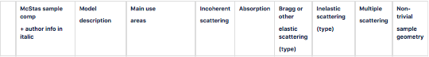
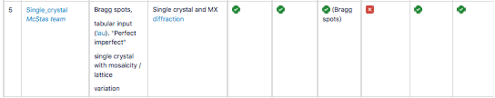
Sample overview reminder: Currently, SX + inelastic not so easy…
Single_crystal is elastic only….

Slide 3
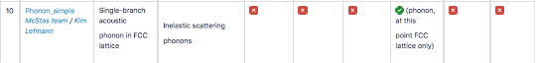
Sample overview reminder: Currently, SX + inelastic not so easy…
Phonon_simple is inelastic only….
(and BCC only…)

Slide 4
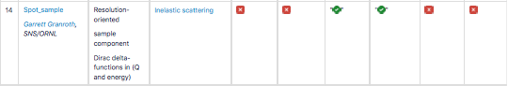
Sample overview reminder: Currently, SX + inelastic not so easy…
Spot_sample is “not a material”, provides 𝛿-functions in Q,⍵ only

Slide 5
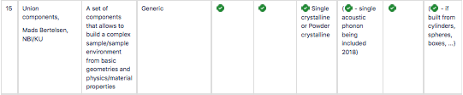
Sample overview reminder: Currently, SX + inelastic not so easy…
Union components allow to combine features of Single_crystal and Phonon_simple + adds phonon polarisation

Slide 6
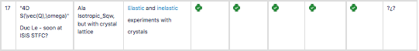
Sample overview reminder: Currently, SX + inelastic not so easy…
Contribution from Duc Le, ISIS STFC is not in the code tree yet: It is unfortunately McStas 2.0
specific. Provides a “4D equivalent” of Isotropic_Sqw - and has flat sampling in that 4D-space: relatively slow, big files, requires lots of statistics

Slide 7
But - could we do a hack maybe?
How about using Monte Carlo to choose between the different components? :-)
I.e.:
0.3 x
+
0.7 x

Slide 8

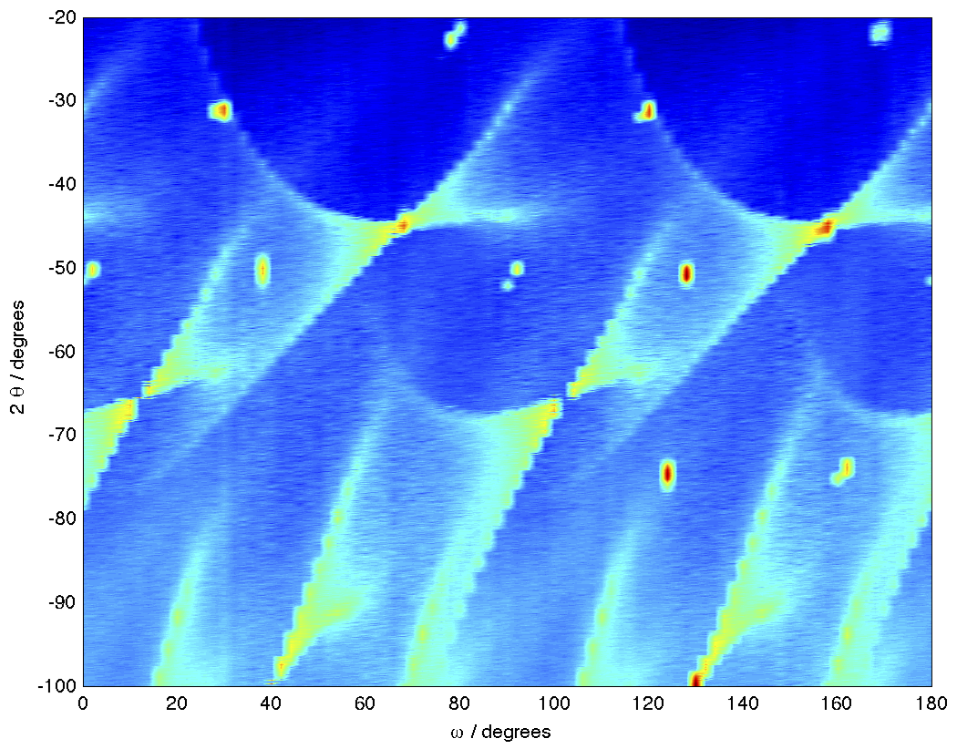
… there is a hack, recipe:
INITIALIZE %{
declare select_sample;
%}
Arm ()
…
EXTEND %{
select_sample = rand01();
%}
COMPONENT SX= Single_crystal(…)
WHEN (select_sample < 0.3)
…
COMPONENT Phonon = Phonon_simple(…)
WHEN (select_sample >= 0.3)
…

Slide 9
In this exercise you will have access
to an instrument that uses this type of hack
The instrument is found on the DropBox:
Magnon_bcc_visualisation.instr
and needs the .lau and .comps also found there:
BCC_fake.lau
Magnon_bcc.comp
Sqq_w_monitor.com
!! PLEASE COPY FILES ACROSS - WORKING DIRECTLY IN /media/sf_Shared_folder CAN CAUSE ISSUES !!
(For the time being, skip the TAS_Magnon.instr instrument)

Slide 10
In this exercise you will have access
to an instrument that uses this type of hack
The instrument is found on the DropBox:
Magnon_bcc_visualisation.instr
and needs the .lau and .comps also found there:
BCC_fake.lau
Magnon_bcc.comp
Sqq_w_monitor.com
(For the time being, skip the TAS_Magnon.instr instrument)
New, purely inelastic component
from Kim Lefmann 2018.

Slide 11
In this exercise you will have access
to an instrument that uses this type of hack
The instrument is found on the DropBox:
Magnon_bcc_visualisation.instr
and needs the .lau and .comps also found there:
BCC_fake.lau
Magnon_bcc.comp
Sqq_w_monitor.com
(For the time being, skip the TAS_Magnon.instr instrument)
Magnons are related to spin- waves, but there are subtle
differences - Sylvain? :-)

Slide 12
SPIN WAVES = MAGNONS
MORE GENERALY
MAGNONS : ΔS = 1 EXCITATIONS

Slide 13
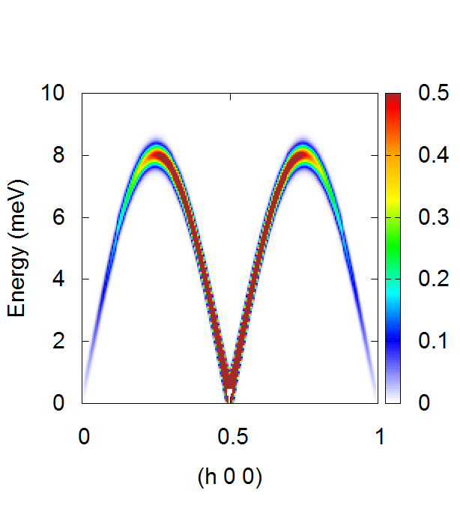
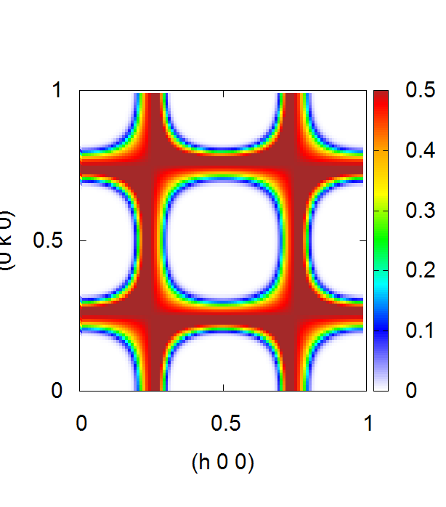
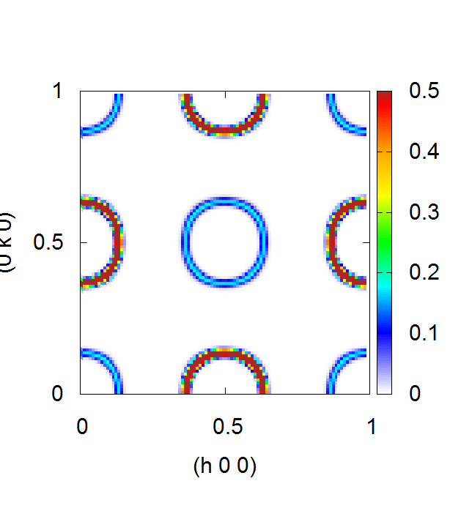
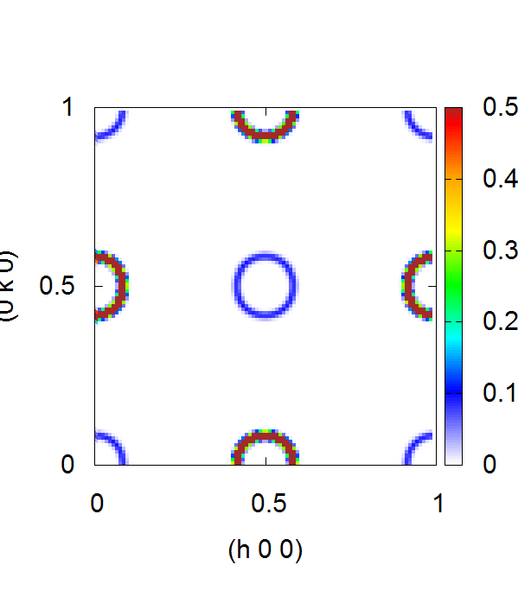
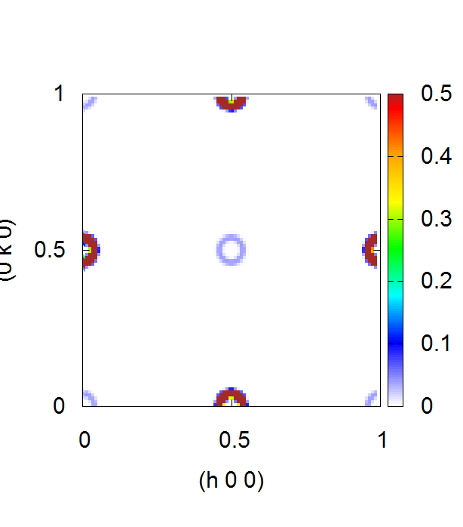
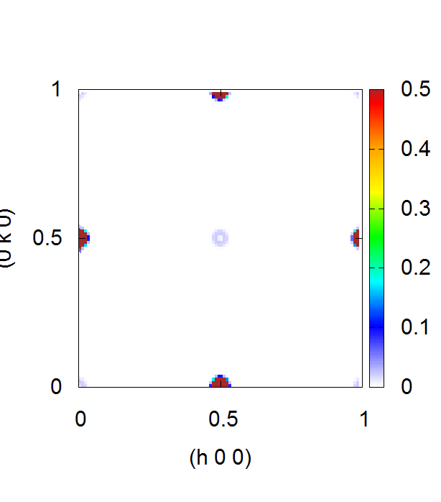
« Slicing a cone »

Slide 14
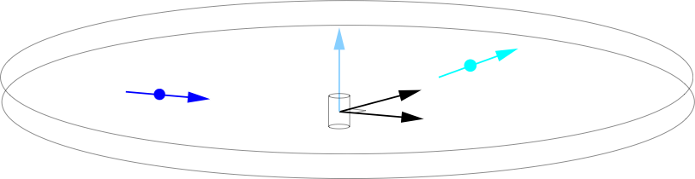
Instrument contents
White-beam source
Selection between Single_crystal and Magnon_bcc.comp
A “scattering-plane” inelastic monitor that “cheats” by directly measuring ki and kf

Slide 15
Tasks:
Locate the instrument file, compile and visualise “as usual”
In terminal run mcdoc Magnon_bcc_visualisation.instr
In terminal run mcdoc Magnon_bcc.comp and check how comp is used in the instrument file
In terminal run mcdoc Sqq_w_monitor.comp check how comp is used in the instrument file
Run a long simulation (1e7-8) and plot the results (log)

Slide 16
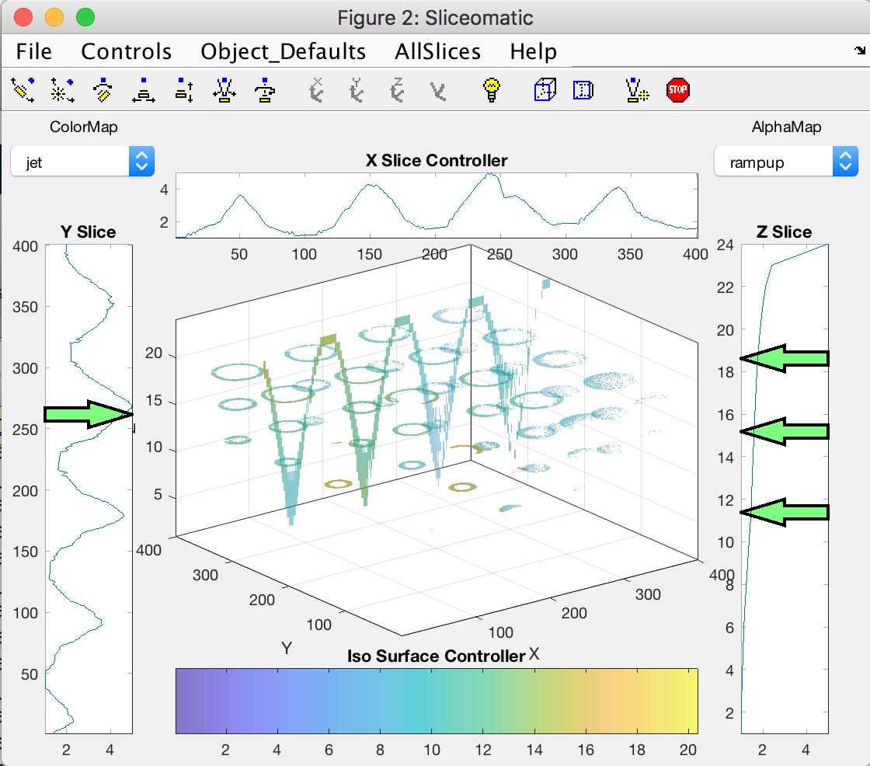
Tasks - 2
5. Load and view in Matlab / iFit using:
- use the loadvol.m script from the DropBox
Vol=loadvol(’your_datadir’);

Slide 17
Optional exercise
6. If you are longing for some more TAS :-)
Try modifying TAS_Magnon.instr for the same Single_crystal and Magnon_bcc setup as found in the visualisation instrument
Make it work and do some nice scans :-)

Slide 18
Optional exercise
7. Try including a Phonon_simple instead of the Magnon_bcc component - use either of the previous instruments

